Slide 1
ASSOCIATION OF MEDICAL WOMEN NAGPUR
ACTIVITY REPORT
DEC.25- JUNE-26
DR. GIRA SONI
HON. SECRETARY AMWN

Slide 2
HEALTH CHECK UP CAMP – 11 JANUARY 2026
AMWN organised a health check up camp in collaboration with Shri Shrimali Soni Mahila Samaj at Kacchhi Visa Lad Samaj Bhavan.
Free blood sugar, B.P. check Up, Uric acid Test, Bone Density Test and Health Education was given by Dr. Anjali Chivhane- President AMWN and Dr. Gira Soni- Secratory AMWN to common public.
Free glucometers and free diabetic diet recipe books were distributed to needy patients by AMWN.
More than 100 people participated in this camp

Slide 3
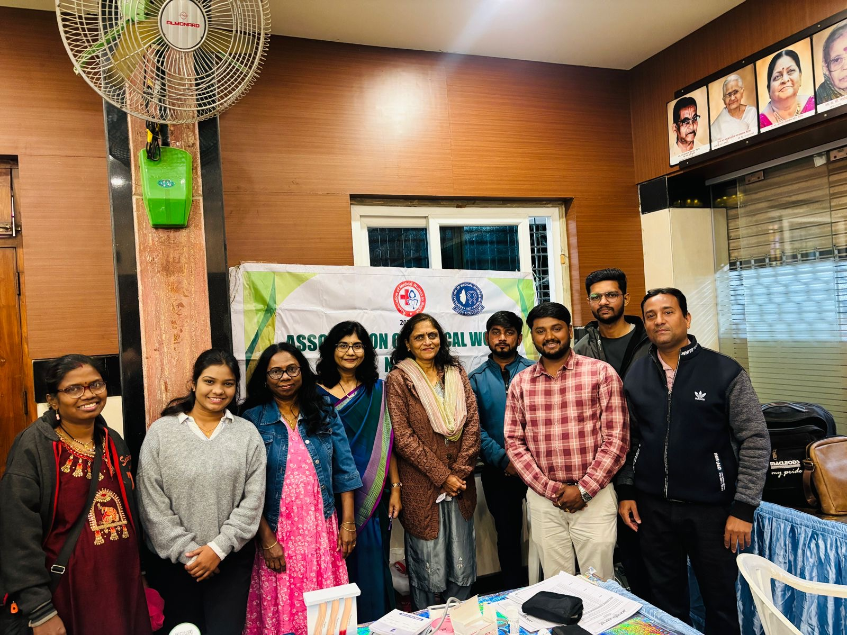
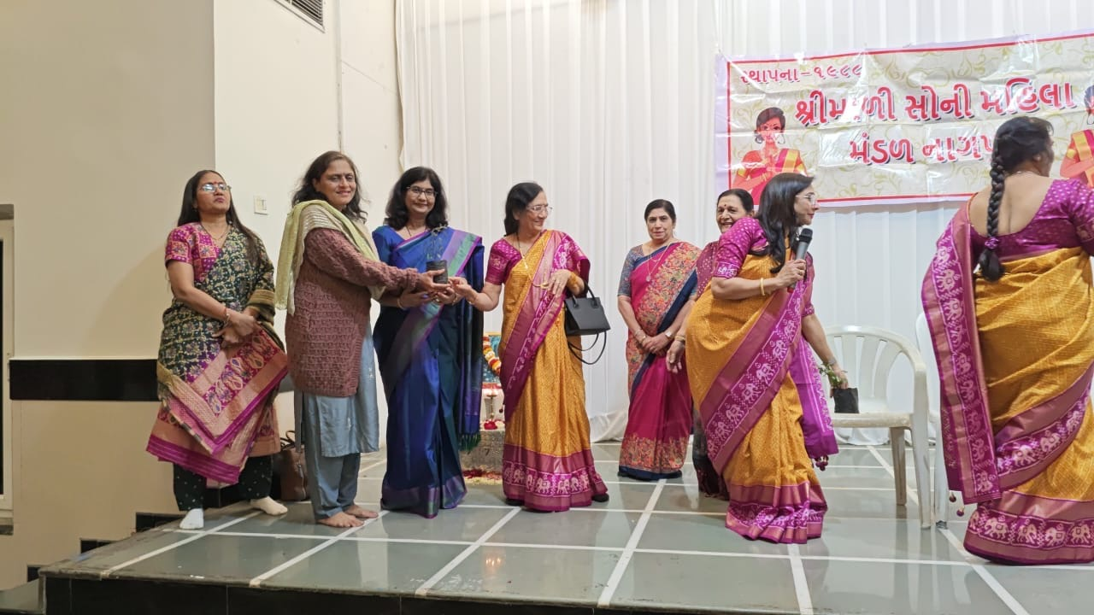
Glimpses of the camp

Slide 4
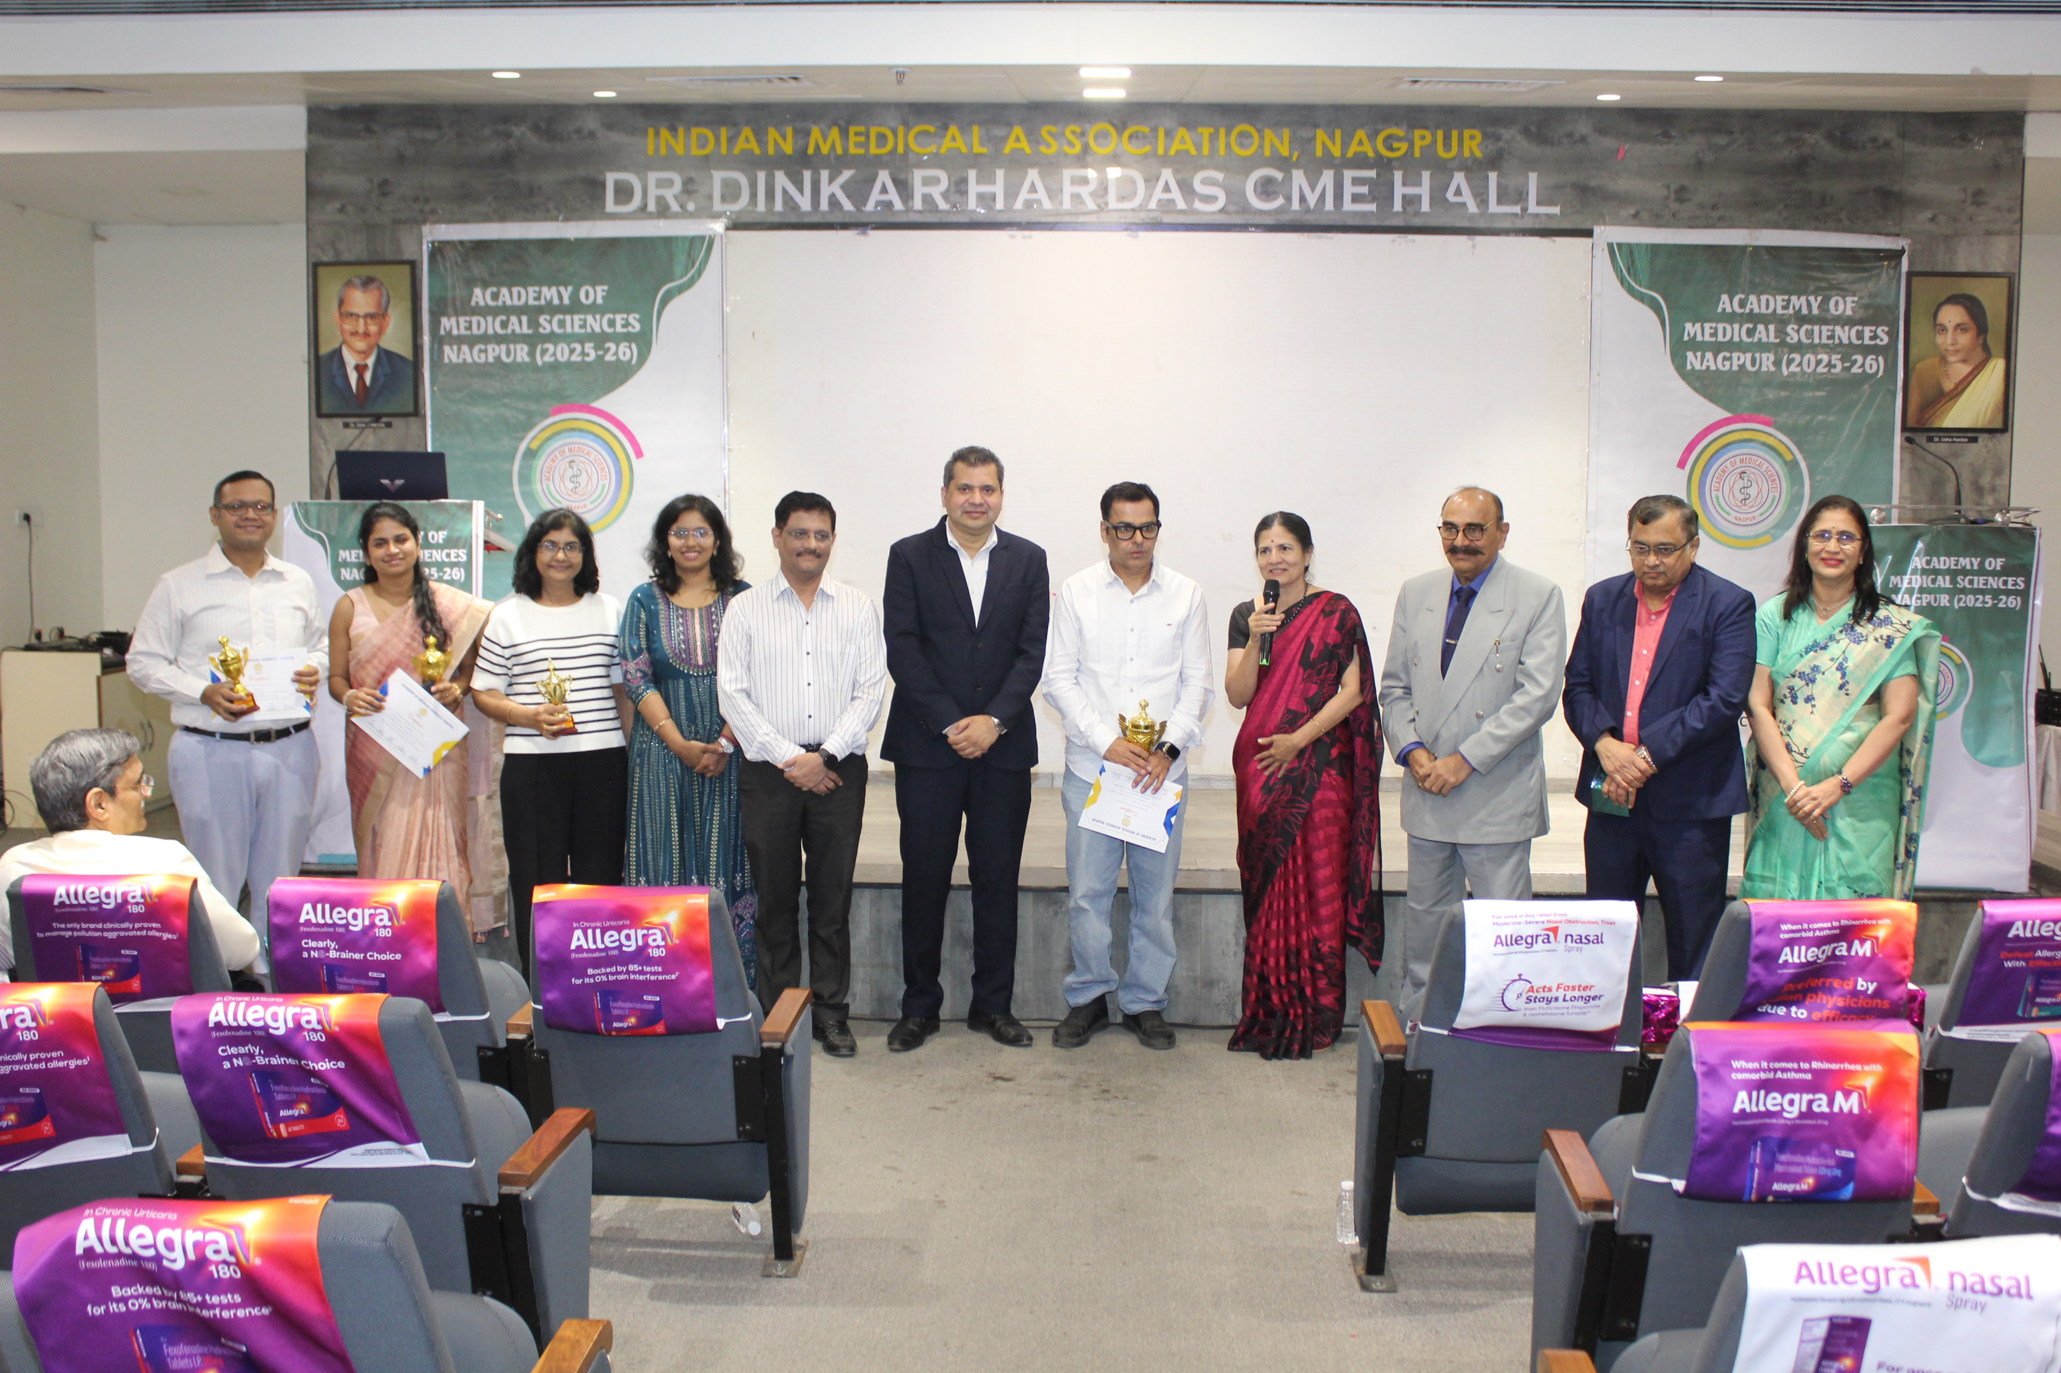
DEBATES IN MEDICINE-22 FEBRUARY
Dr. Gira Soni, Secretary- AMWN won the second prize in the programme “Debates in
Medicines” organised by Academy Of Medical Sciences, Nagpur. She spoke for the motion - Will GLP 1 Agonists will replace the bariatric surgery in near future?

Slide 5
WOMAN’S DAY CELEBRATION – 8 March
International Woman’s Day was celebrated by organising a health awareness programme in women on 8 March at Traffic Park Nagpur.
Dr. Rekha Sapkal , a senior gynecologist and an author spoke on prevention and management of urogenital cancers in women.
Dr. Charu Baheti, an infertility specialist spoke on role of HPV vaccines in adolescent girls to prevent cervical cancer in future.
Dr. Anjali Chivhane felicitated the speakers.
Dr. Yamini Alsi was felicitated for her cancer awareness efforts to spread awareness among common people.

Slide 6
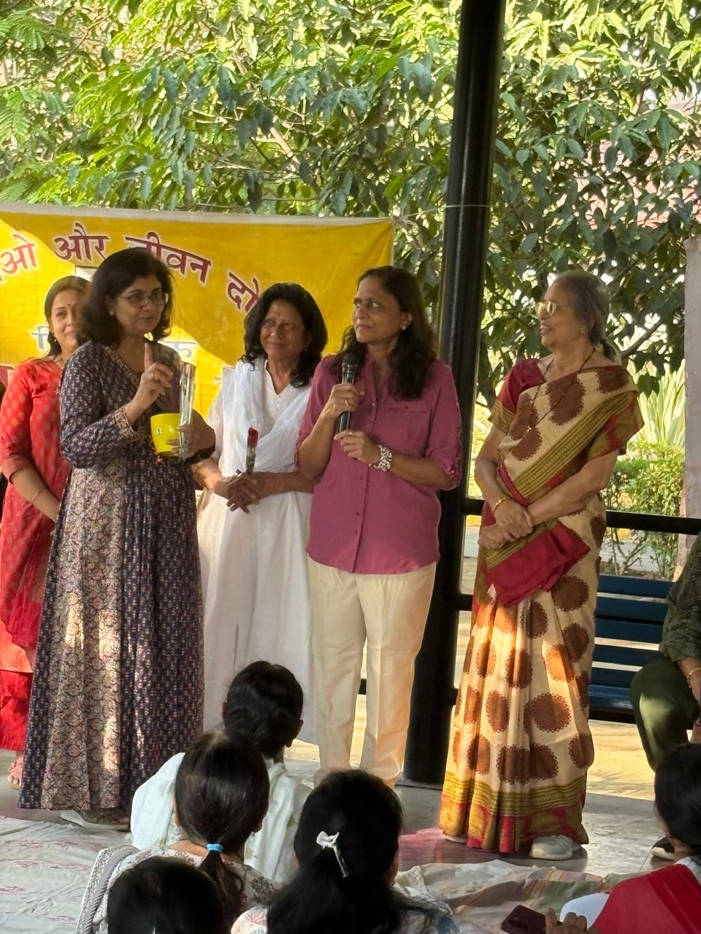
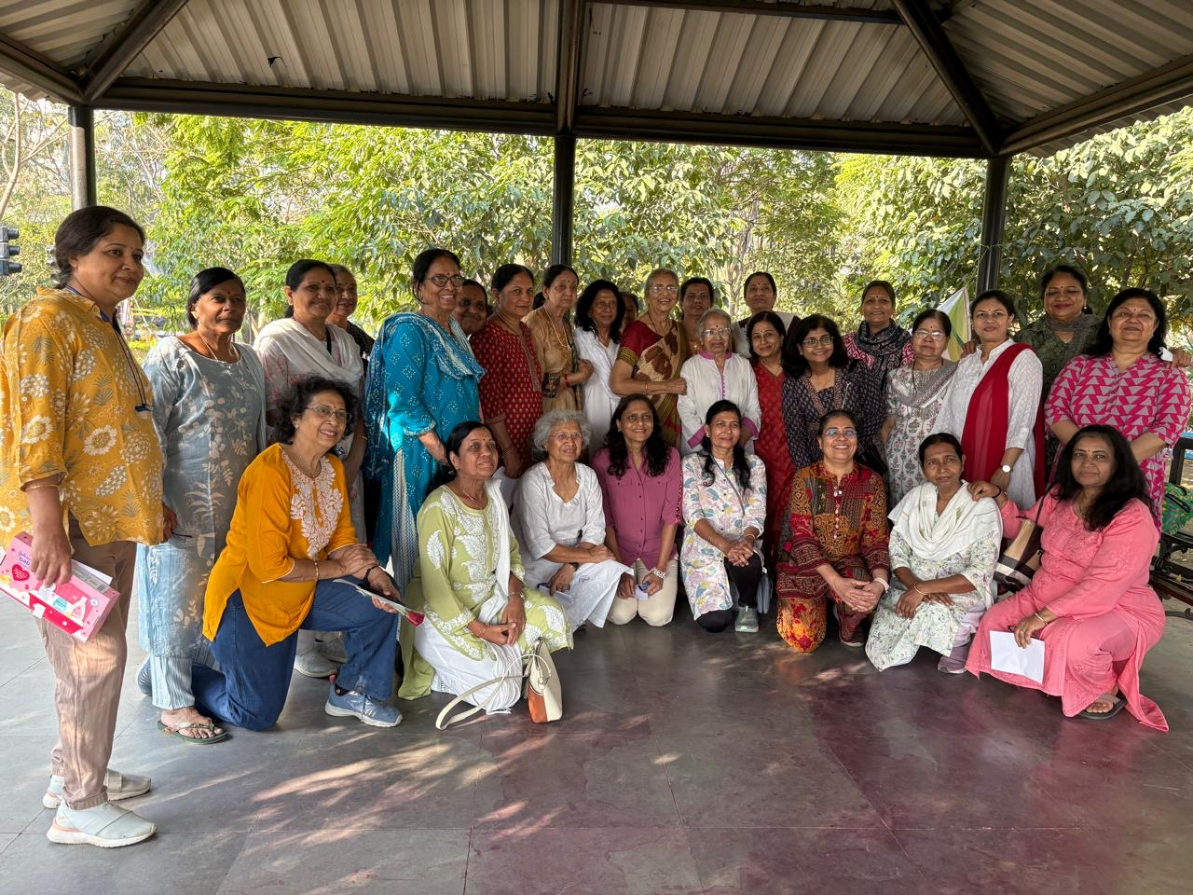
GLIMPSES OF THE PROGRAMME

Slide 7
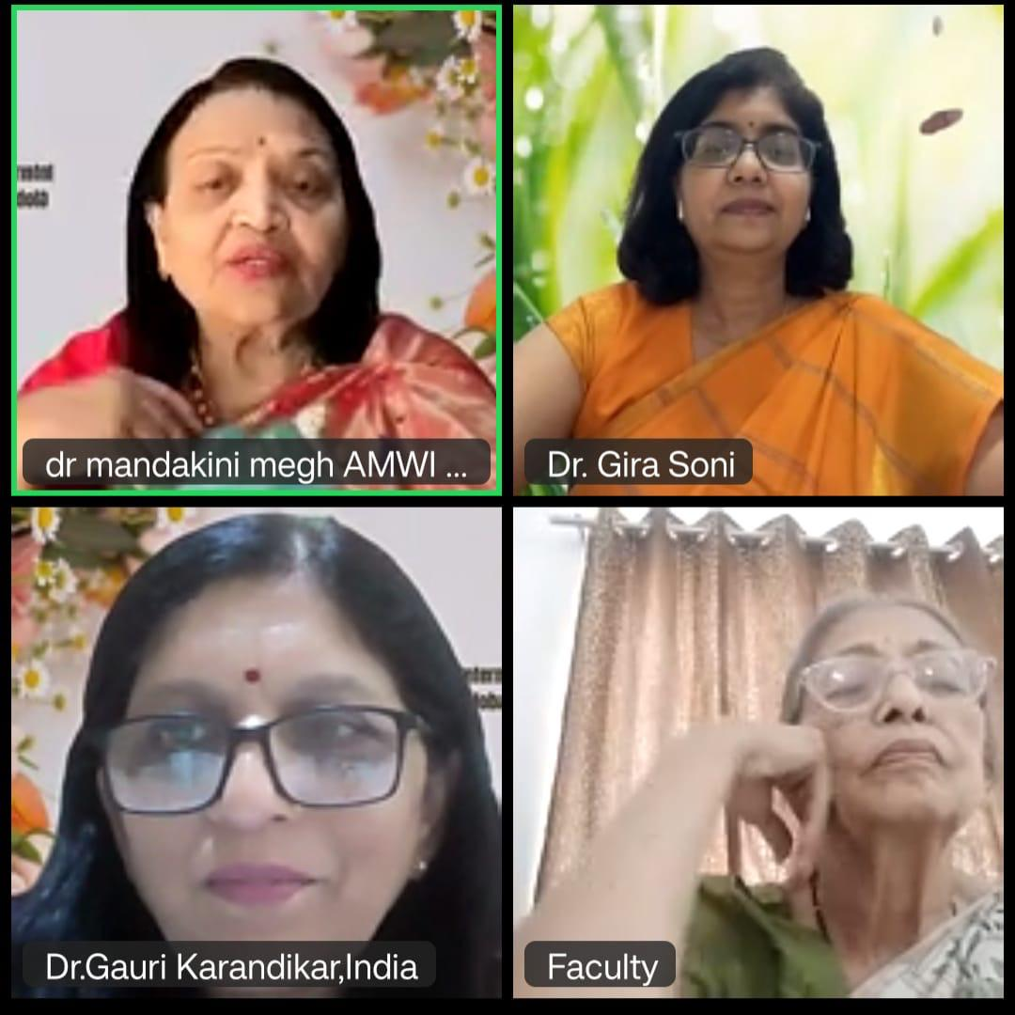
Golden jubilee award by ASSOCIATION OF MEDICAL WOMEN INDIA – 6 march
Dr. Gira Soni received Golden Jubilee Award from Association Of Medical Women India (AMWI) for her exemplary and original work on Gestational Diabetes.

Slide 8
ACHIEVEMNTS OF AMWN MEMBERS
Dr. Sunita Lawange, President of Pain Society of India was a keynote speaker and felicitated at Kathmandu, Nepal in the Nepal Pain Conference on 11 May 2026.
Dr. Anupama Bhute represented India at the AI for Good Global Summit 2026 in Geneva, Switzerland on 17 July.
Dr. Pragati Khalatkar won a runner up crown in the beauty paegent organised by West Zone YUVA FOGSI at Amravati on 25 June.

Slide 9
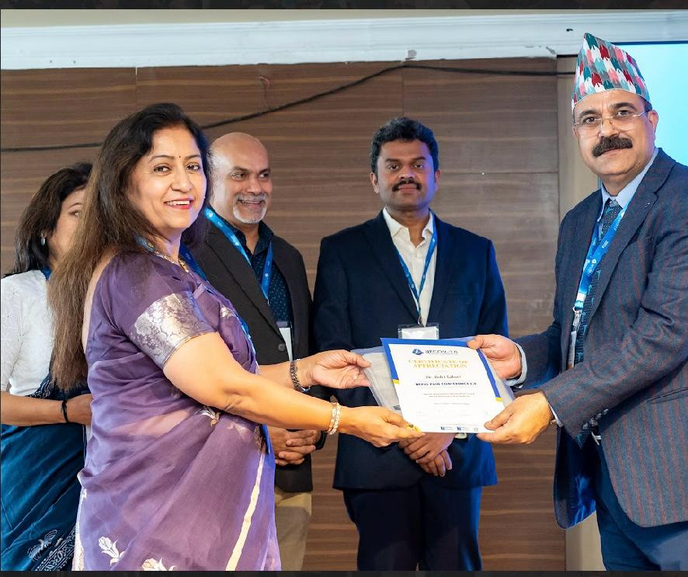
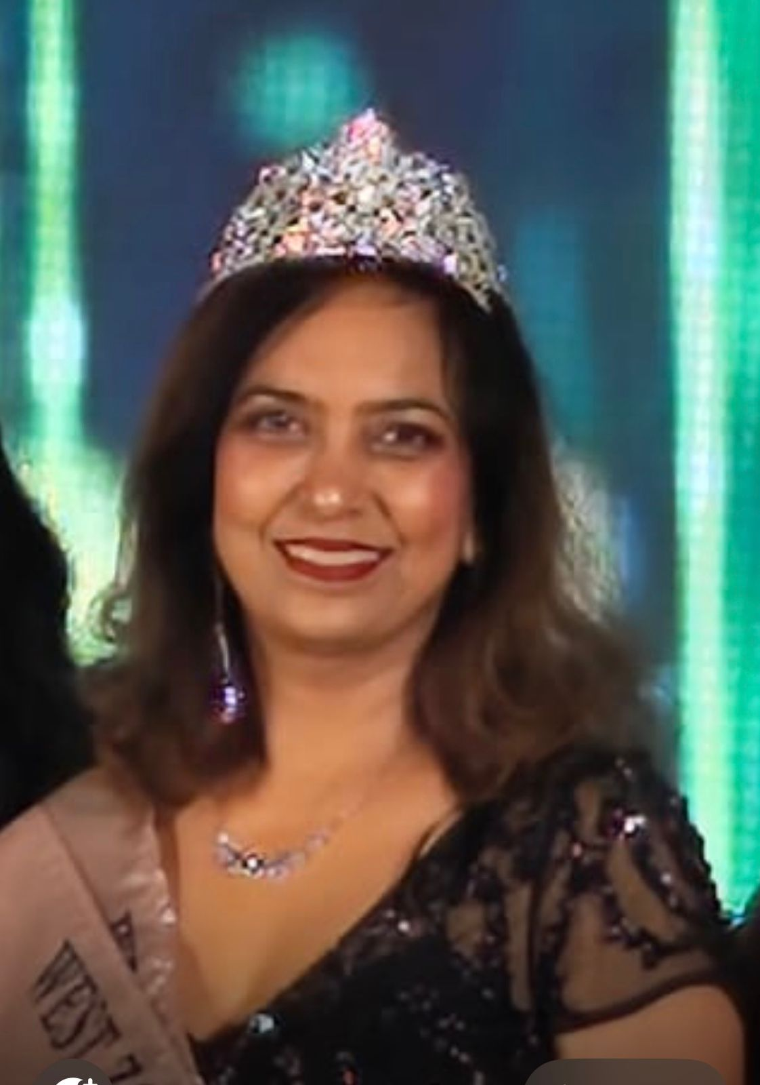
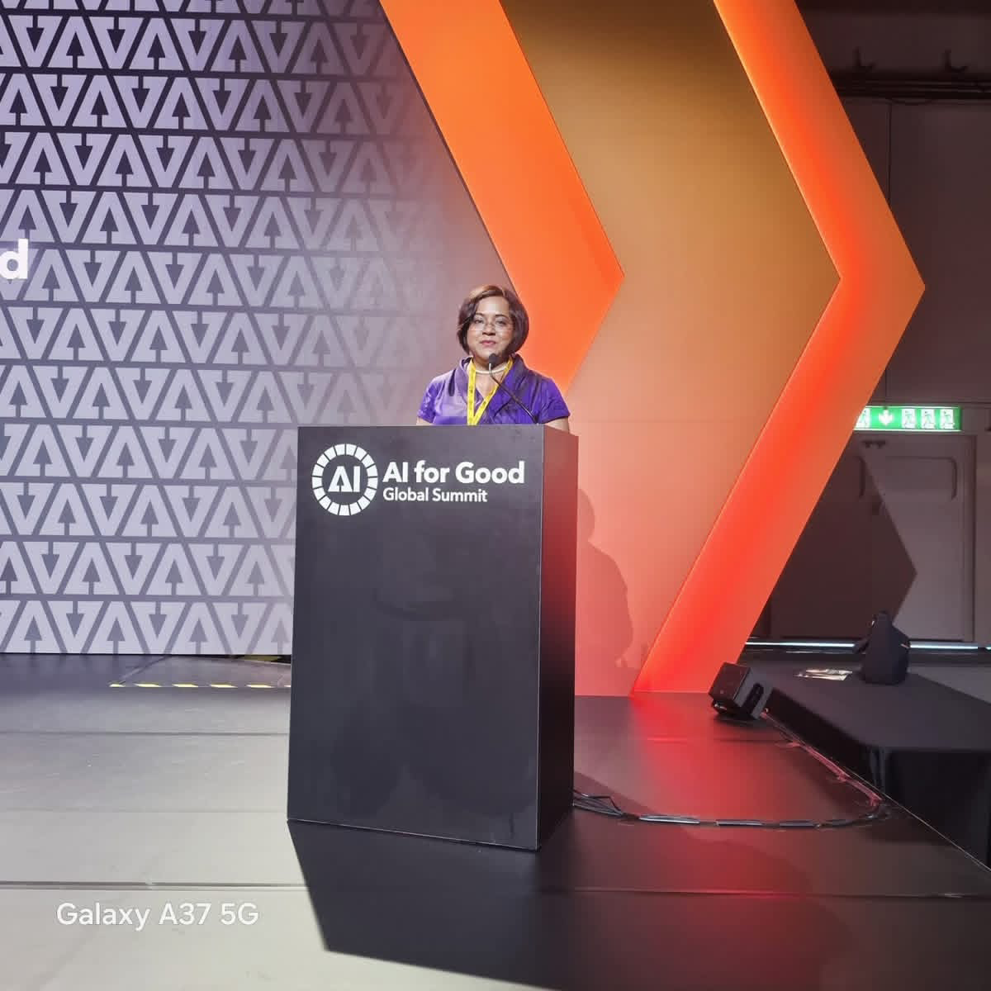
Glimpses of the moments

Slide 10
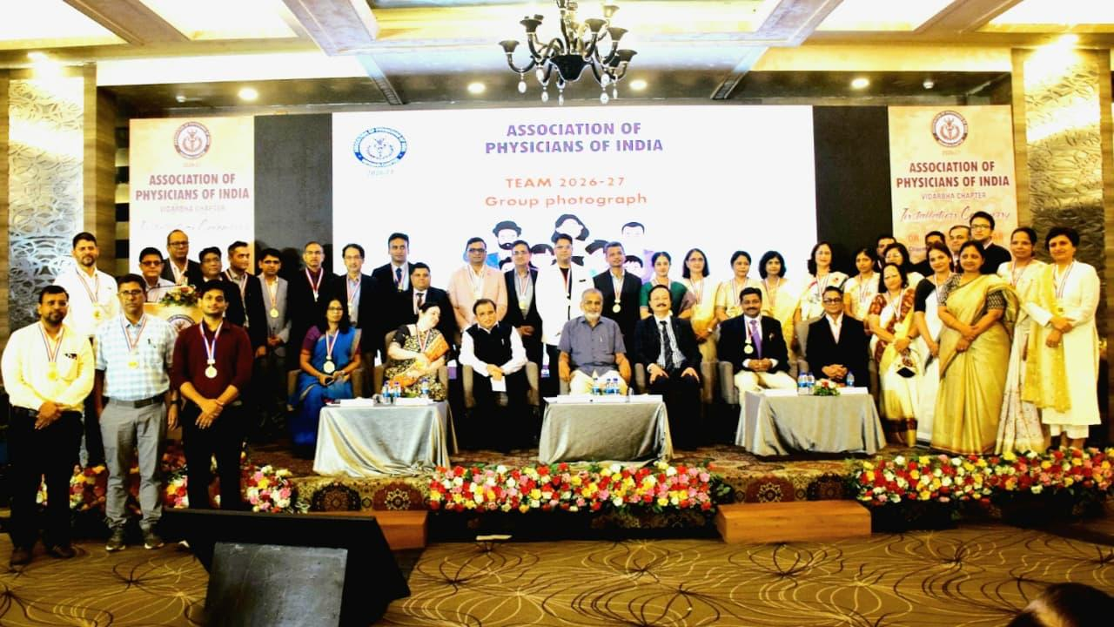
Achievents of the AMWN members
AMWN members Dr. Tanuja Manohar – a physician and Dr. Ashwini Tayade – a infectious disease specialist installed as a president and secretary respectively of Association Of Physicians Vidarbh Chapter (API-VC) on 1st June at Nagpur.

Slide 11
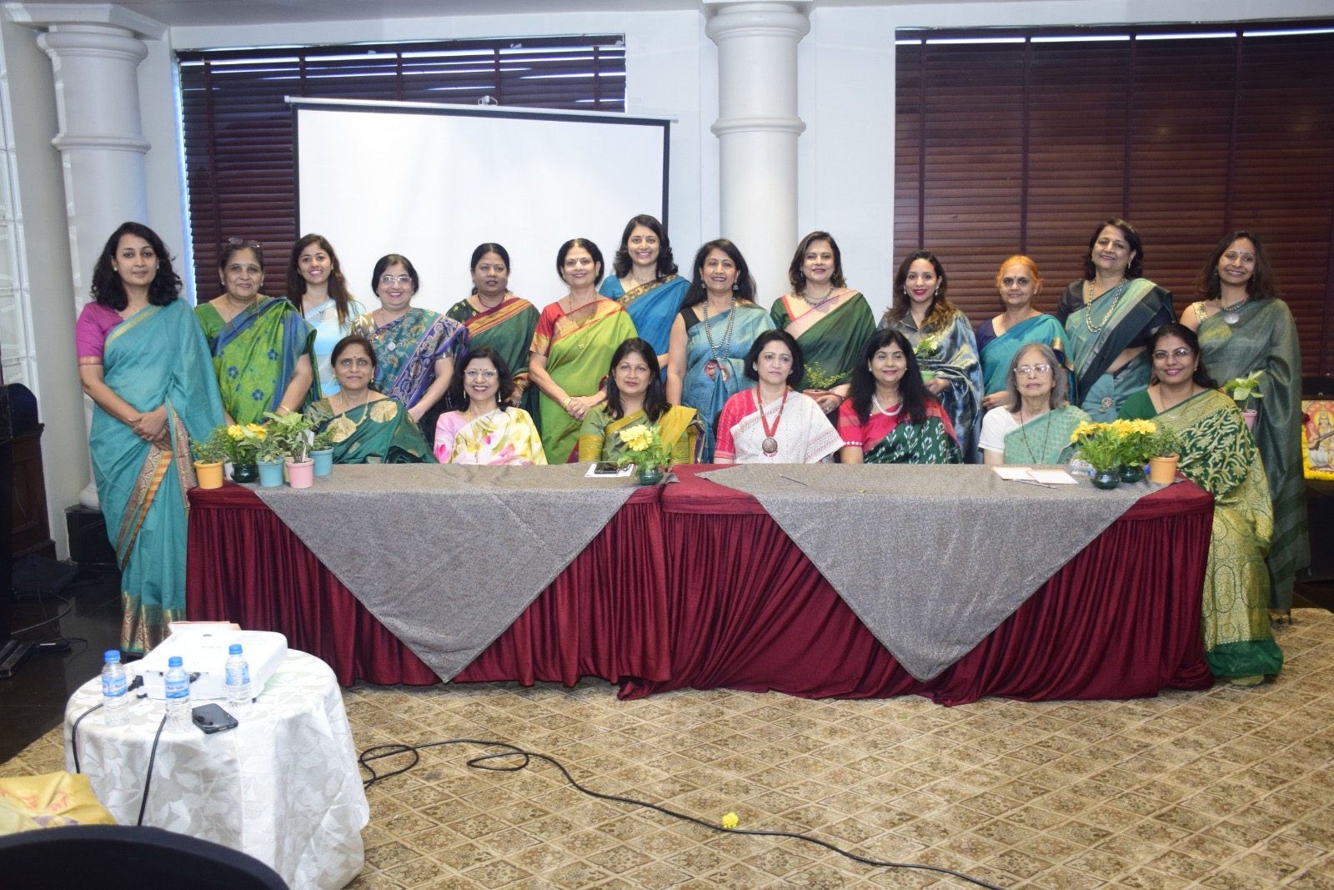
Thank you

